Slide 1

Microsoft TeamsFX
Thomy Goelles Team Lead @SOLVION | Microsoft MVP (Office Development) @thomyg

Slide 2
Imagine…

Slide 3

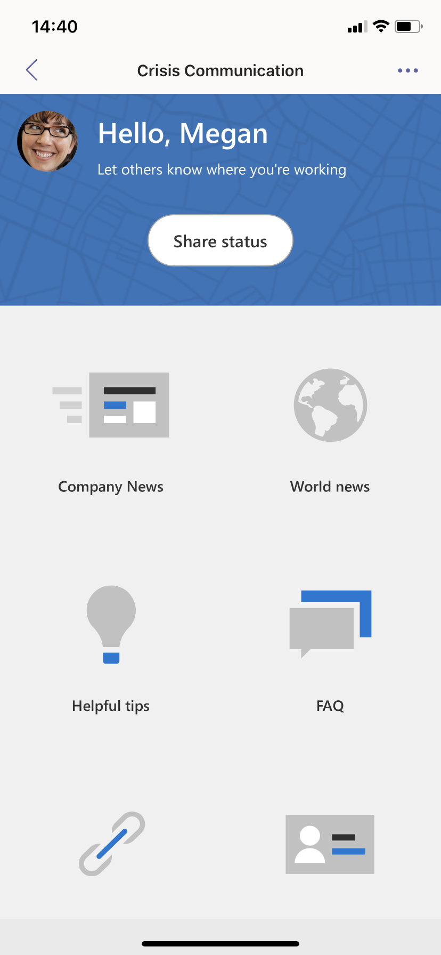
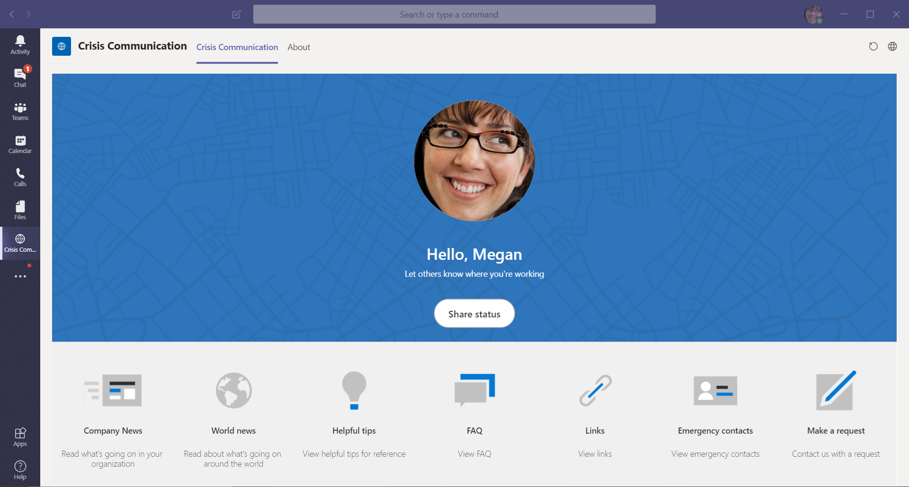
Communicate effectively
Notes:
Get important information from your organization no matter if you are behind your desk or on the go

Slide 4
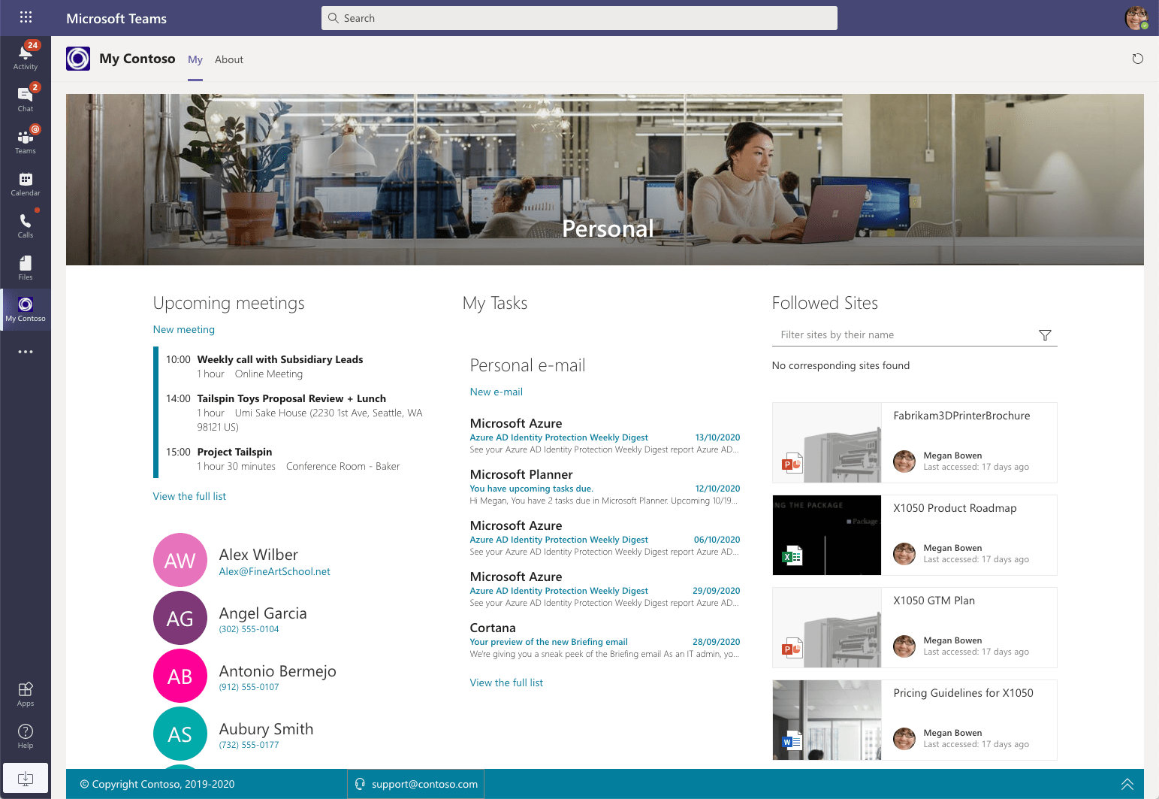
Stay in
the know
Notes:
Stay in the know with what’s happening and what’s going to happen around you and your team

Slide 5
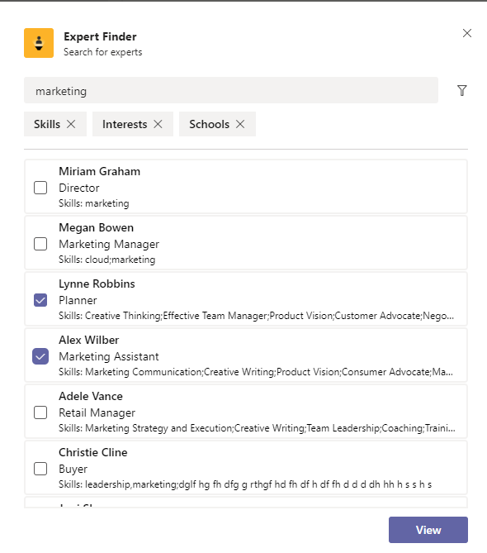
Find experts
Notes:
Find experts in your organization no matter if you know them personally or not

Slide 6
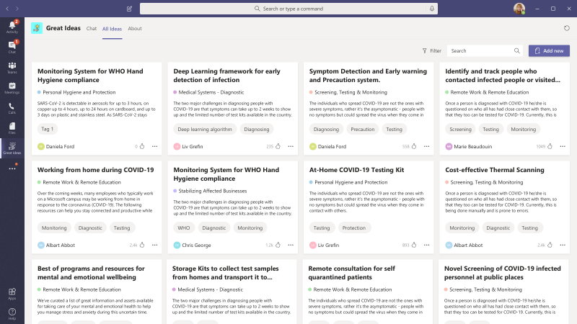
Share
ideas
Notes:
Share ideas and get feedback from others in your organization

Slide 7
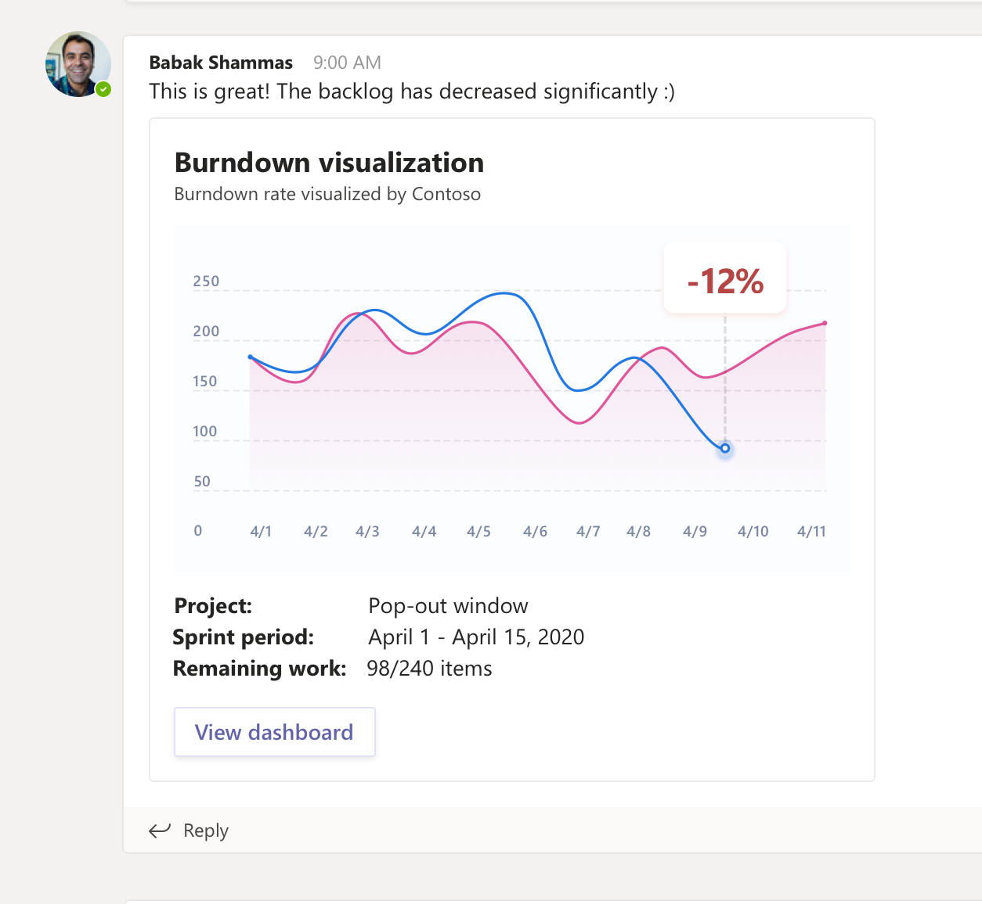
Track progress
Notes:
Track progress of your work in the context of your work

Slide 8
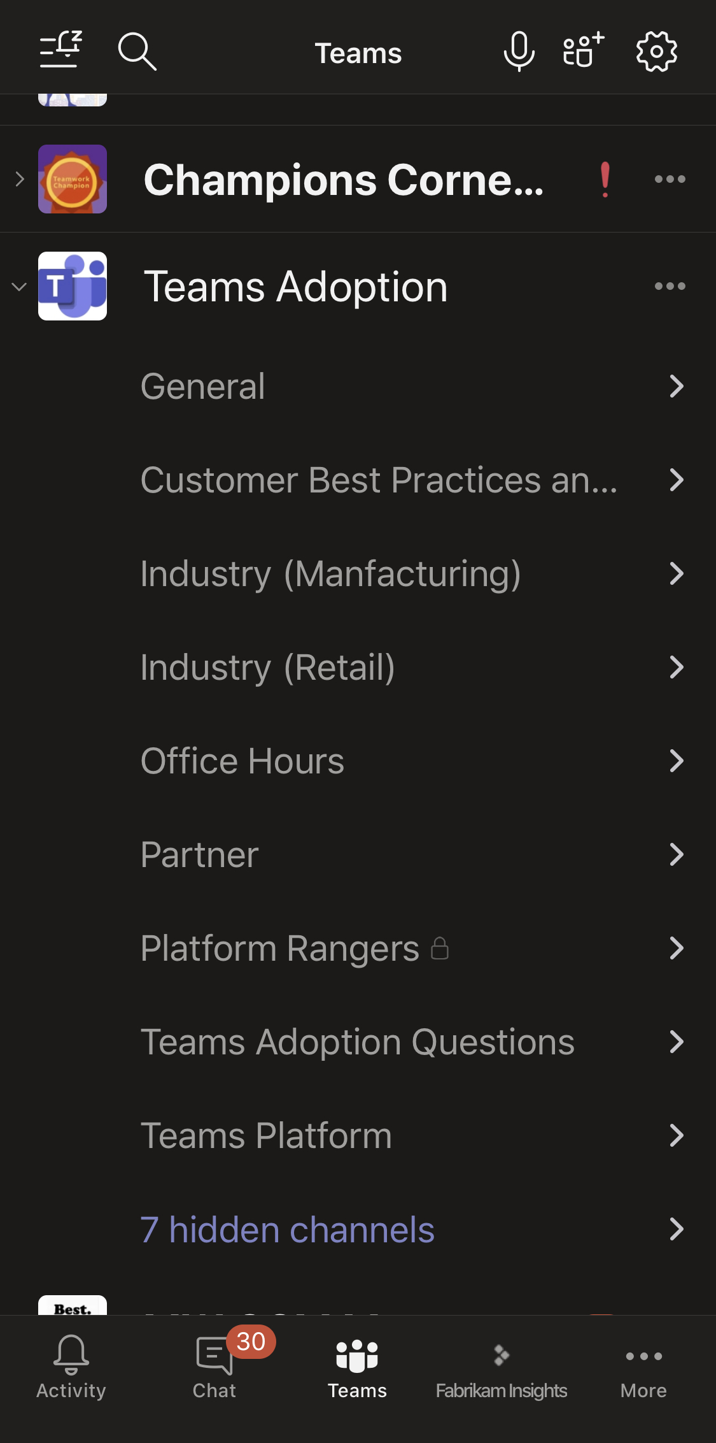
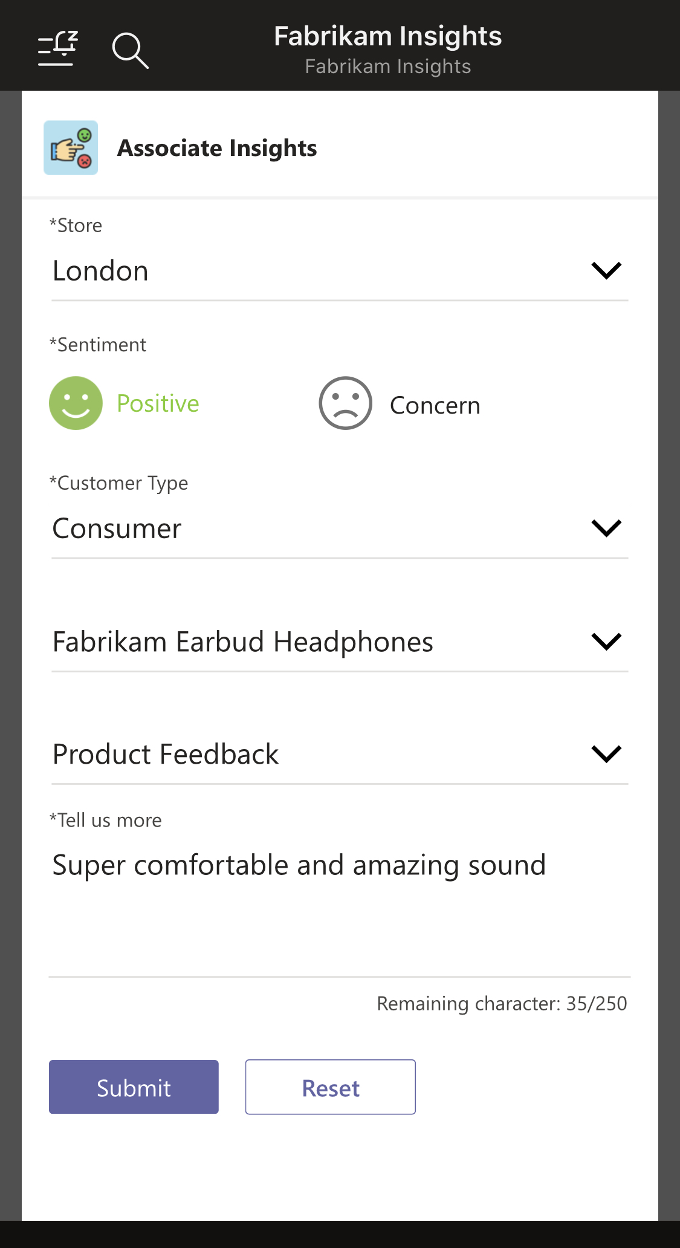
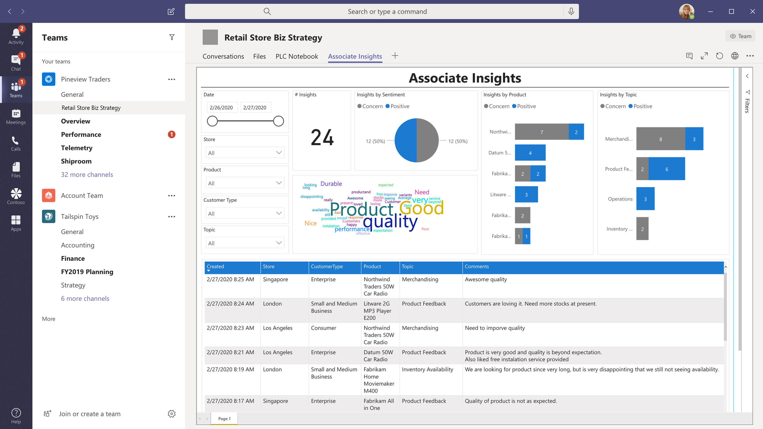
Capture feedback
Notes:
Capture feedback and understand where you can improve

Slide 9





M365 framework
a
b
c
d
e
Fluent UI, Graph Toolkit, Adaptive Cards
a
Microsoft Graph
b
Community
Notes:
What’s available today
Build on any OS/platform
SDKs
Tooling
Microsoft
Community
Extend Teams, SharePoint and Office
Common UI language
Powered by Graph
SDKs
Graph Toolkit
Supported by community

Slide 10


















Evolve how your people work, with the tools they need
Vertical solutions
Healthcare
Manufacturing
Retail
Banking
Custom
Apps
Organization-based applications
Departmental tools
Employee resources
Support & info
Processes & workflow
Partner applications
Ready to use
Office 365
applications

Slide 11







Tabs, Personal Apps
Bots
Existing Applications
New Applications
Notifications
Your custom app or service
Messaging Extensions
Your custom app or service
Your custom app or service
Microsoft Teams
Connectors & Webhooks
Task Modules

Slide 12













Build custom apps on Microsoft Teams to meet your unique needs
Microsoft Bot Framework
Tabs, Personal Apps
Bots
Web Technologies
SharePoint
Framework (SPFx)
Notifications
Your custom app or service
Messaging Extensions
Power Platform
Microsoft Teams
GitHub
Connectors & Webhooks
Task Modules
Microsoft Graph
Visual Studio + Visual Studio Code

Slide 13
Build custom apps on Microsoft Teams to meet your unique needs
Microsoft Bot Framework
Tabs, Personal Apps
Bots
Web Technologies
SharePoint
Framework (SPFx)
Notifications
Your custom app or service
Messaging Extensions
Power Platform
Microsoft Teams
GitHub
Connectors & Webhooks
Task Modules
Microsoft Graph
Visual Studio + Visual Studio Code

Slide 14

Teams provides a powerful and extensible platform
Build apps using capabilities and entry points to empower your users in chat, channels, and personal workspace
Distribute and manage your app
Tabs
Bots
Enterprise Developers
Upload to your organization’s app catalog
Surface rich content within Teams
Help users get tasks done in conversations
Messaging extensions
Notifications
ISVs Partners
Publish to Microsoft AppSource and the Teams app store
Allow users to query and share cards in conversations
Post updates to channels via connectors
Connectors & Webhooks
Task modules
Connect web services to channels and teams
Initiate and complete tasks or display information
Administrators
Assign policy for apps over end users. Preinstall and pre-pin apps to drive adoption
Microsoft Graph
Power your apps using Graph. Build intelligence and connect to data that drives productivity

Slide 15
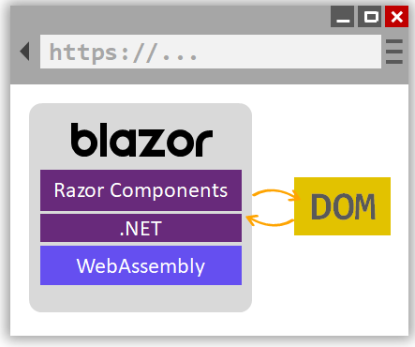
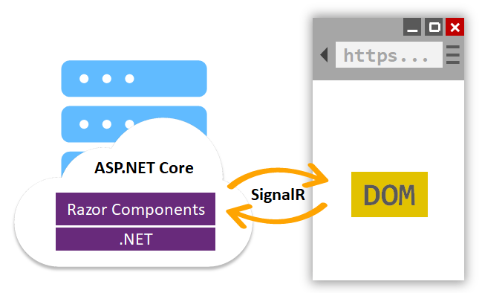
What is Blazor

Slide 16
What is Blazor
client-side
server-side
https://blazor.net

Slide 17



The easiest way to get started building apps for Microsoft Teams Teams Toolkit Preview
Project Generator Tabs, Bots, Message Extensions, Samples | 🗸
F5 & Debugging | 🗸
Identity | Single-Line Auth
Front-end Hosting | 🗸
Integrated Azure Functions | 🗸
Microsoft Graph | Single-Line Graph
Azure SQL | 🗸
SPFx integration | 🗸
Deployment Automation | 🗸
Bicep Templates | 🗸
Publishing | 🗸
Extensibility | 🗸
CLI | 🗸
Blazor Support | 🗸
Automatic Tunneling | 🗸

Slide 18
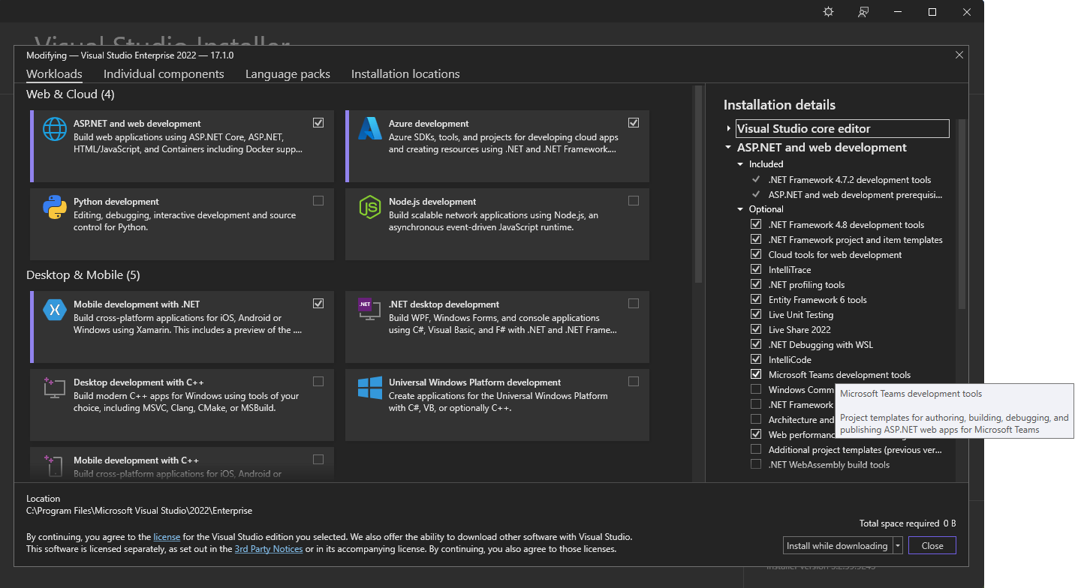
Teams Toolkit Options
Visual Studio 2019: Teams Toolkit Extension
Visual Studio 2022 starting with 17.1.0 – Component in the VS Installer under “ASP.NET and web development”

Slide 19
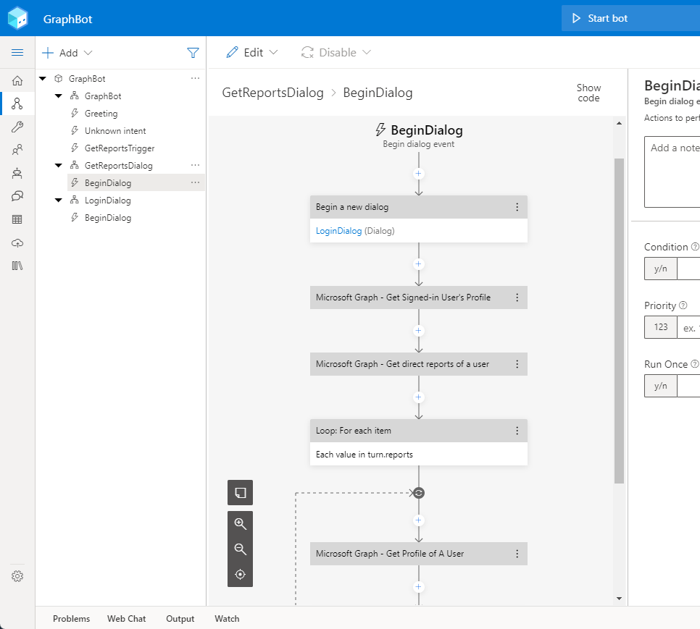
Demo Build a Composer Bot all powered by the Graph

Slide 20
Learn
Reuse
Share
Microsoft 365 Patterns and Practices
Notes:
You’re not alone
Sample code, guidance and docs available for you to reuse
Community of like-minded people to help you out
Focus on your app and stay productive

Slide 21
Microsoft 365 Patterns and Practices (PnP)
>600 samples
>1,680
awarded
for helping to learn to extend Microsoft 365
Contributors in GitHub organizations
Internally at Microsoft as a reference model for community engagement
aka.ms/m365pnp
>73,000
>63,000
>3.4 million
Visitors in GitHub organizations in past 2 weeks
Tenants using open-source components each month
Watch time minutes in the YouTube channel within last 365 days

Slide 22
Next steps
See examples of extending Microsoft Teams aka.ms/templates-teams
Try Teams Toolkit aka.ms/teams-toolkit
Learn more about building for Microsoft Teams aka.ms/start-teams
Get started with Bot Framework Composer aka.ms/bfcomposer

Slide 23
What are you going to build?

Slide 24
Thank you!
Join the next session “Blazor + Bot Framework = Dream team (TEAMS Part)” at the full hour!

